Slide 1
Disaster Tweet Classification Model
By Garima Mahajan

Slide 2
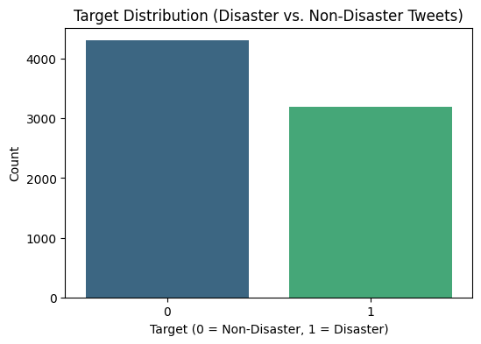
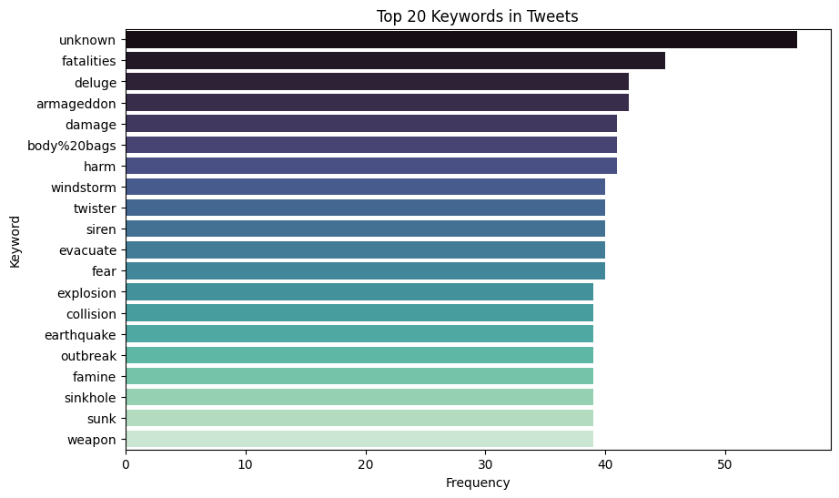
Target Distribution

Slide 3
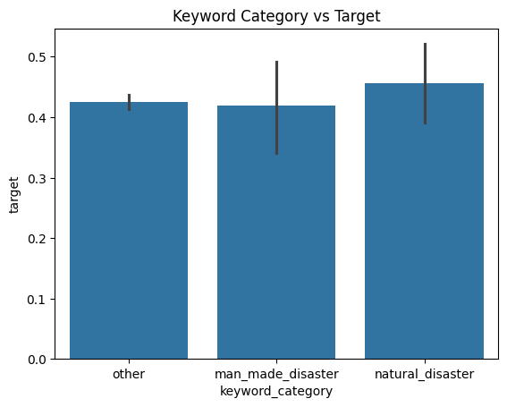
Keyword Category vs Target
Purpose: This bar plot shows the relationship between different keyword categories and the target variable.
Observations:
Natural Disaster: Shows the highest mean target value (around 0.46), indicating these keywords are more strongly associated with the positive target class.
Man-Made Disaster: Displays a slightly lower mean target value (~0.42) but with a larger spread (error bar).
Other: Has the lowest mean target value (~0.43) with minimal variance.
Conclusion: The target variable (likely binary for disaster classification) is more associated with natural disaster keywords compared to other categories.

Slide 4
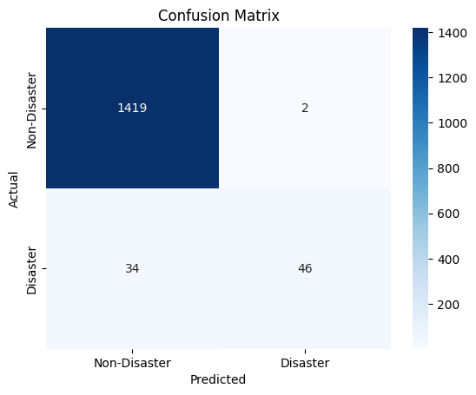
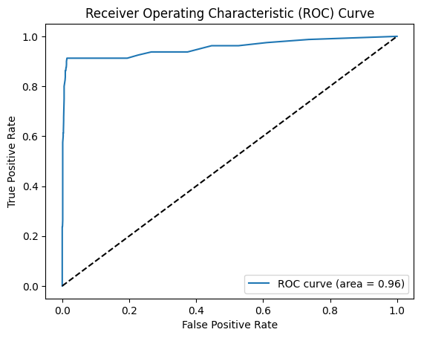
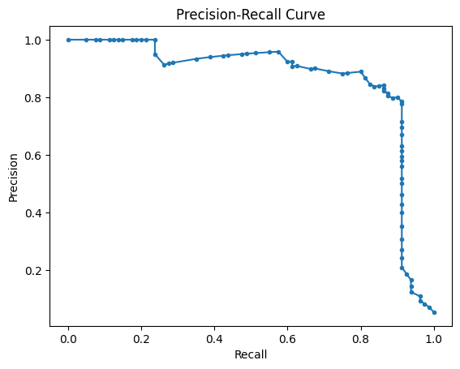
Modelling Results

Slide 5
Receiver Operating Characteristic (ROC) Curve
Purpose: The ROC curve assesses the model’s ability to distinguish between classes.
Observations:
The ROC curve shows excellent performance with an area under the curve (AUC) of 0.96.
The curve is very close to the top-left corner, which indicates a high true positive rate (sensitivity) with a low false positive rate.
Conclusion: The model has high predictive power and can effectively discriminate between the two classes.

Slide 6
Precision-Recall Curve
Purpose: The Precision-Recall curve evaluates performance when focusing on the positive class.
Observations:
Precision remains close to 1.0 for most recall values, highlighting very few false positives.
A slight drop in precision occurs as recall approaches higher values (trade-off between precision and recall).
Conclusion: The model performs well, maintaining high precision across varying levels of recall, which is ideal for imbalanced datasets or disaster-related classification tasks.

Slide 7
Insights Summary
The ROC AUC of 0.96 and strong Precision-Recall curve suggest that the model performs exceptionally well for binary classification tasks.
The keyword category analysis further supports that natural disaster keywords are more predictive of the target variable, followed by man-made disasters and others.
These insights indicate a robust model with excellent generalization and predictive capability.

Slide 8
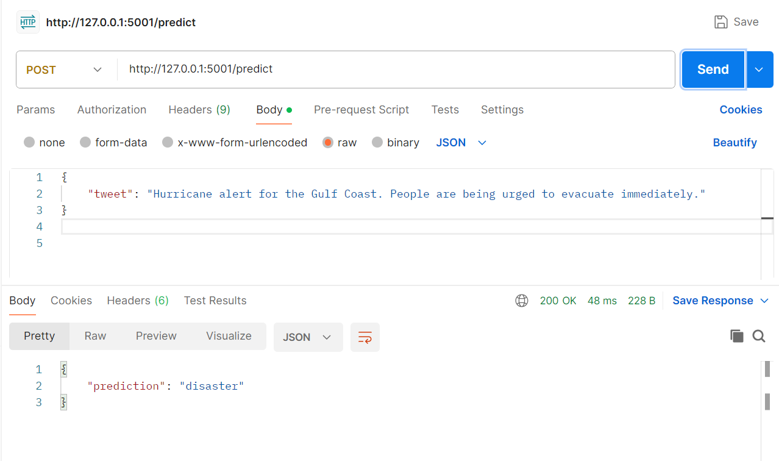
Model API

